Slide 1
Welcome to our presentation

Slide 2
Library management system
Group Member
Name: Md.saharial Alam
ID:17182103334
Name:Mahfuza Tasmeri
ID:17182103328
Name:Alhaj hossen
ID:17182103335
Name:Hasibul Hasan
ID:17182103333
Name:Mehedi Hasan
ID:17182103329
Submitted To:
Ali Azgar
Depertment of CSE
Bangladesh University of business & Technology

Slide 3
Project definition of Library management system
To easy find any books any time and read
To easy to insert any books helps for others

Slide 4
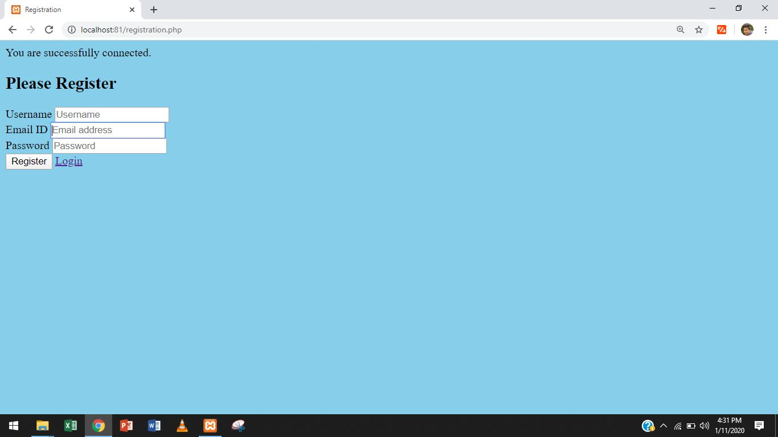
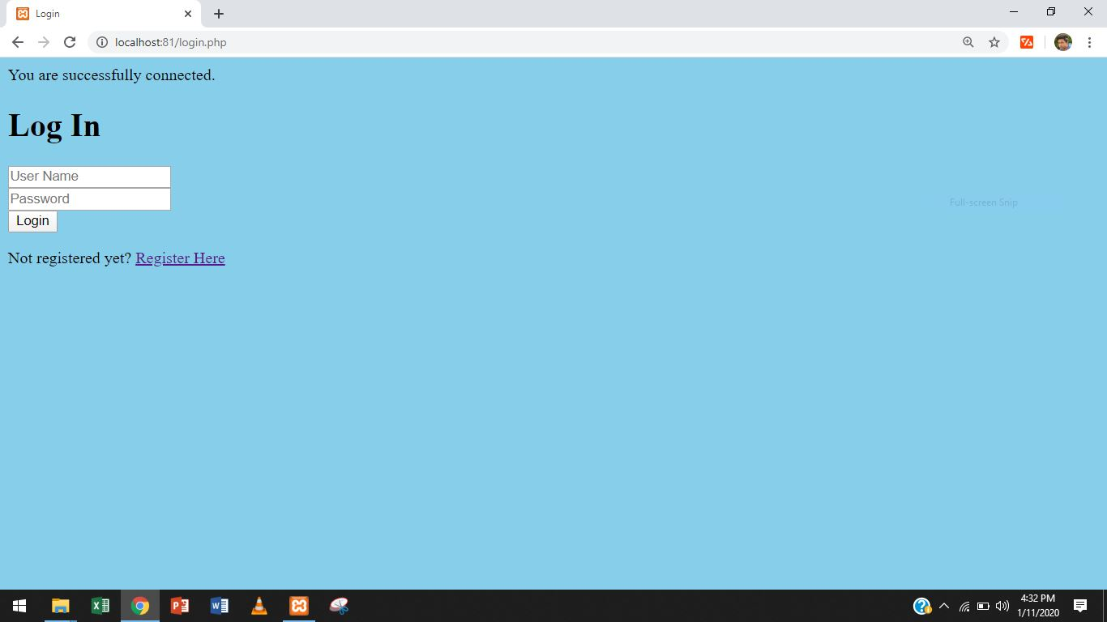

Slide 5
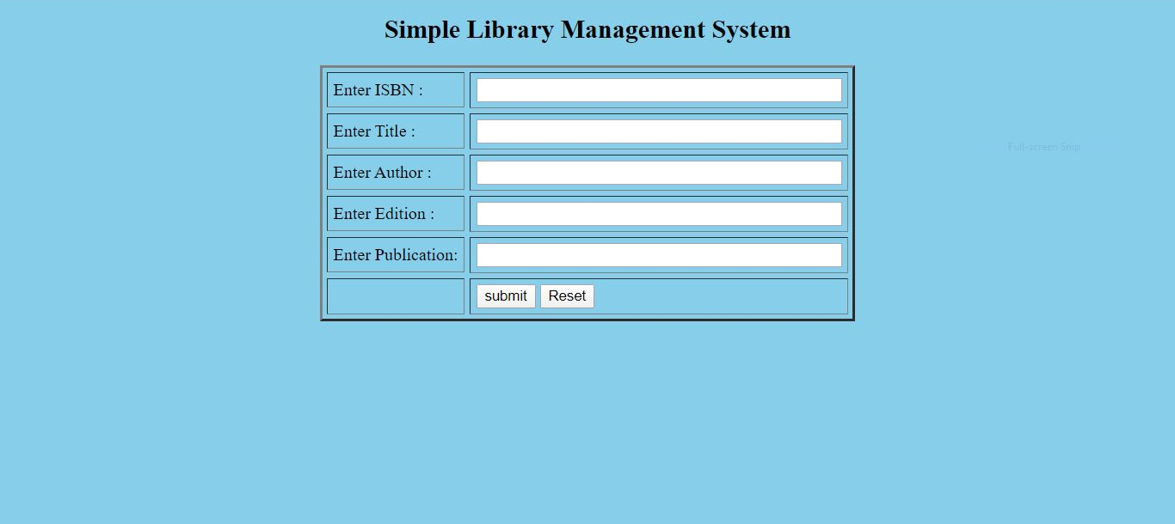
To insert books name

Slide 6
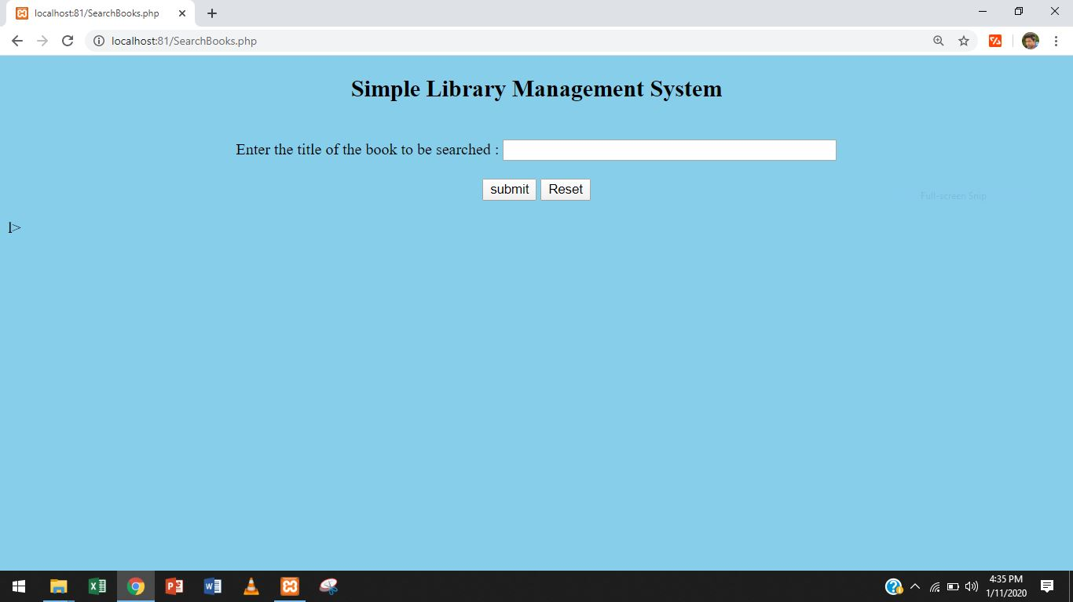
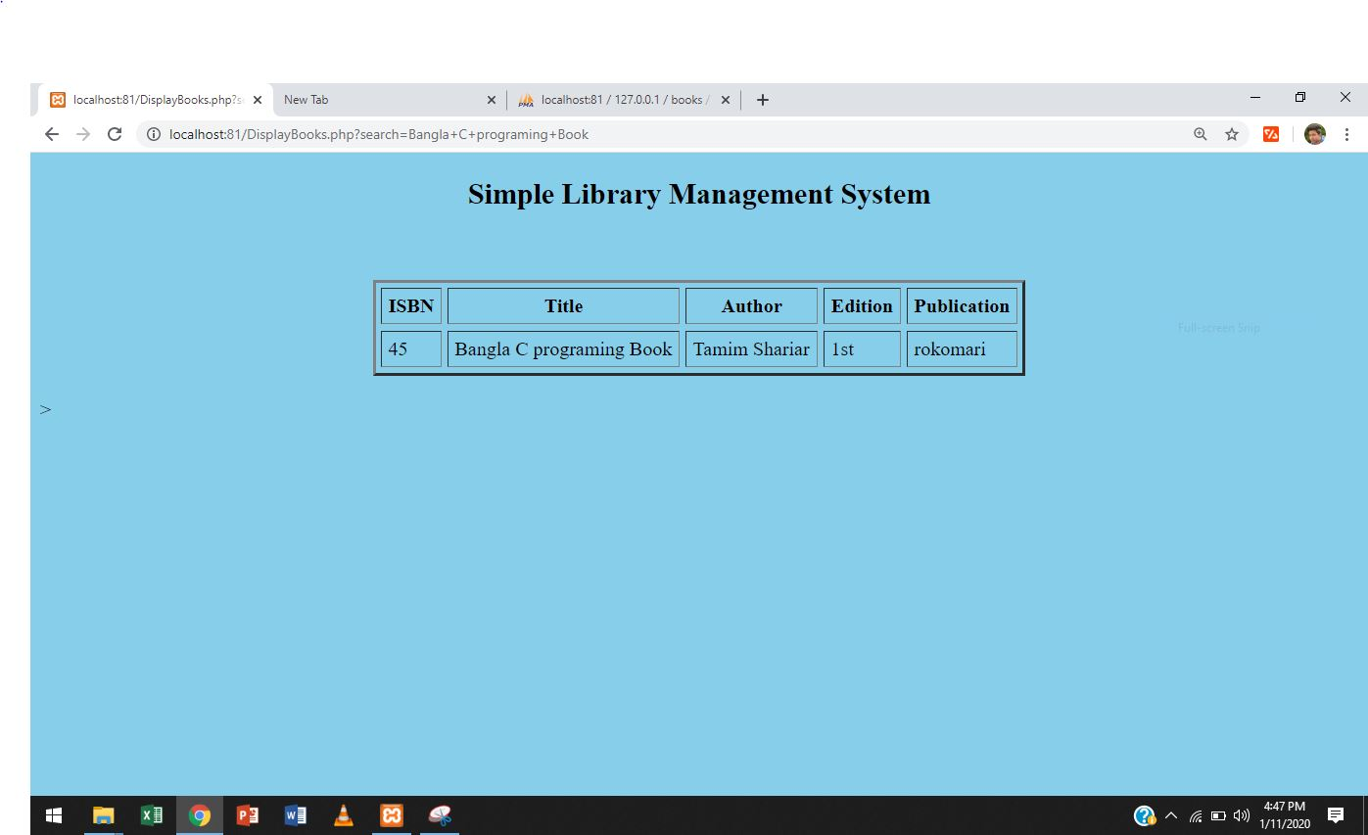
For search any books and find books from database

Slide 7
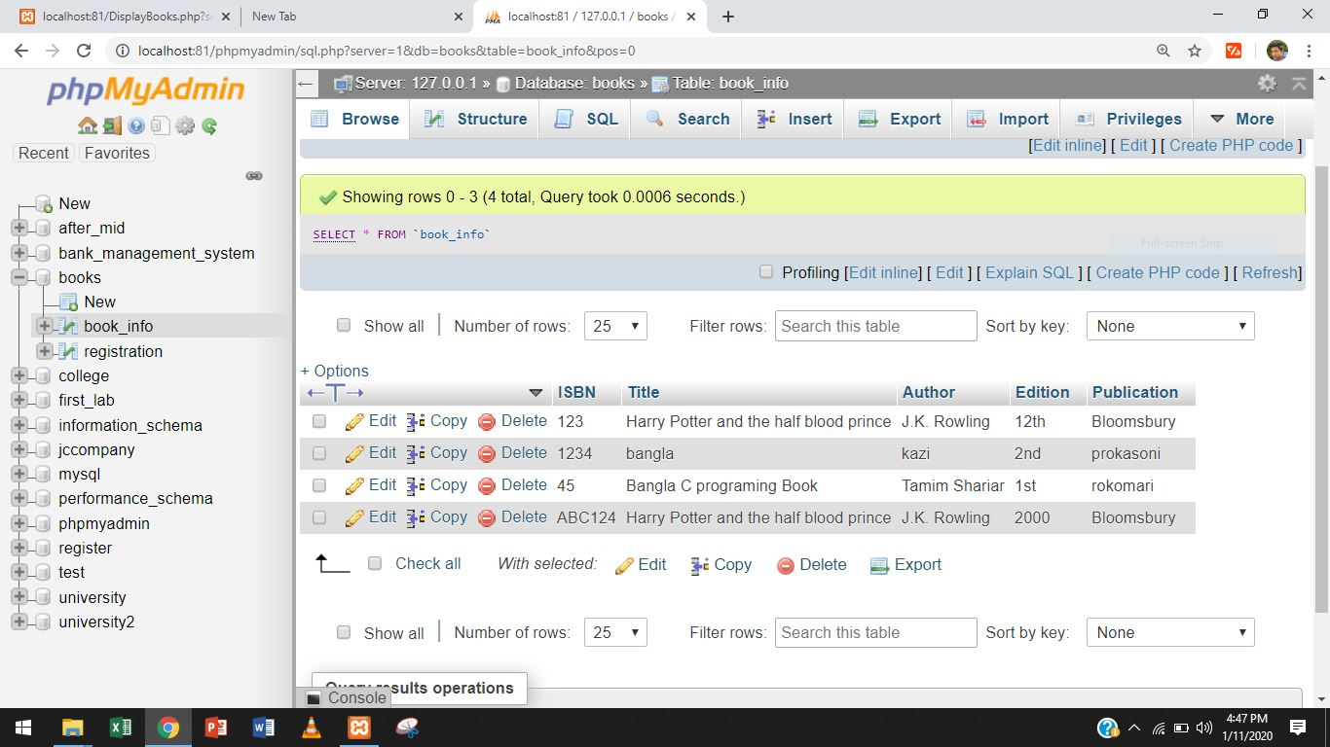
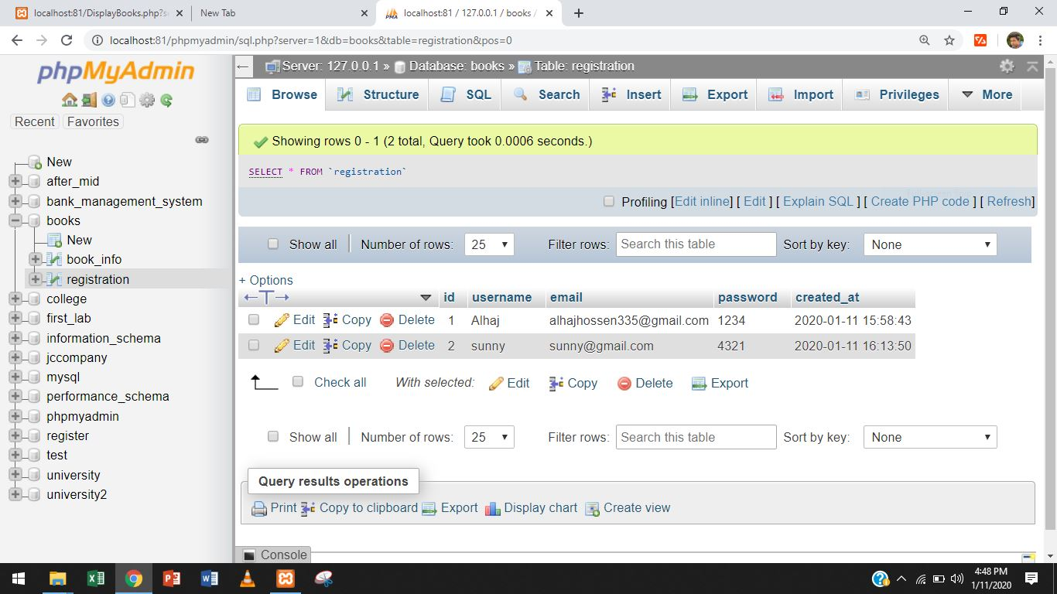

Slide 8
Benefits
Availability
Correctness
Timeliness
Online platform of library

Slide 9
Thanks To All

